Slide 1
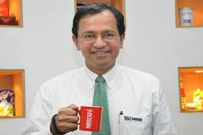
CVSCL CXO Retreat : Oct 2020
Suresh Narayanan – CMD Nestle India Ltd

Slide 2
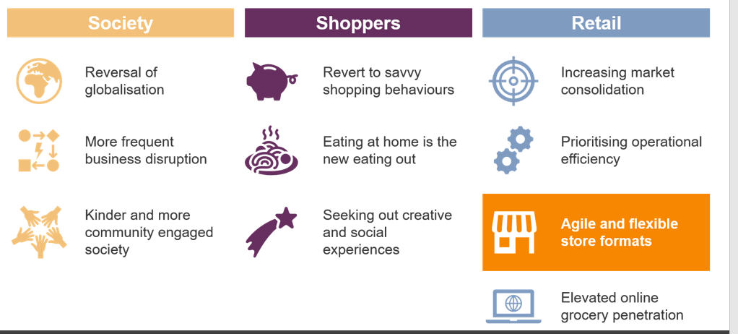
Key Shopper and Retail Trends Post Covid

Slide 3
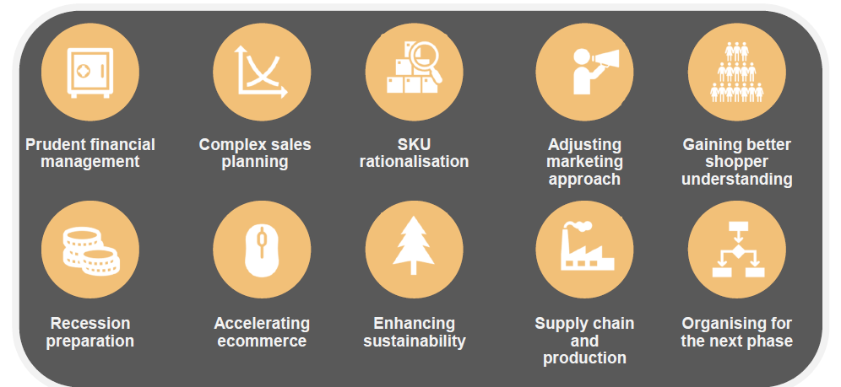
Key Priorities for CPG companies post Covid

Slide 4
CEO Perspective in the New Reality -
– Expectation from Supply Chain Community

Slide 5
Customer and Consumer Centricity –
Passionate, focused and collaborative approach
required to align entire value chain
to be a partner of choice with the Customers

Slide 6
From ENSURING →DRIVE Leadership
Sustain thrust on CONSUMER CENTRICITY
Unleash “Value Chain benefits” as Value Chain Officer
Pivot “Data&Process Management “ to “Business Excellence
Partnerships and Collaborations→”Win win”,Long term
Lead to empower,engage,inspire and win on Purpose &Values
Yoke the best skills in →Big Data,Sustainability+ESG goals

Slide 7
Thank You

